Slide 1

An
Industrial Training Presentation on
“PYTHON”
Carried Out At
Renao Robotics Pvt. Ltd.
(Session 2025-26)
Submitted By:
Name: Naman Bansal
Reg. No: PCEA24CS106
Submitted to:
Faculty Name : MS. Harshita Virwani
Designation: ASSISTANT PROFESSOR
Department of Computer Engineering

Slide 2
Outlines
Introduction to Company (Include Company Name, Domain Area, Size of Company, Place, Background of Company, images etc.)
Prerequisites of the Training
Training Description (Training Instructor’s Name and Profile)
Technology Used (With Details)
Project Description (wherever applicable)
Snapshots of Project (wherever applicable)
Conclusion and Future Scope
References

Slide 3
Introduction to Company
I have done my offline Internship in Python Programming Language from Renao Robotics Pvt. Ltd. For the span of 15 days from 23 June 2025 to 7 July 2025.
It is situated at MANSAROVAR, Jaipur, Rajasthan 302018.
There are 100+ Hiring Partners, 2 lakh Learners, 300+ Institution Tie-ups 100+ Trainers.
UI System is enlightening the young learners for more than 10+ years.

Slide 4
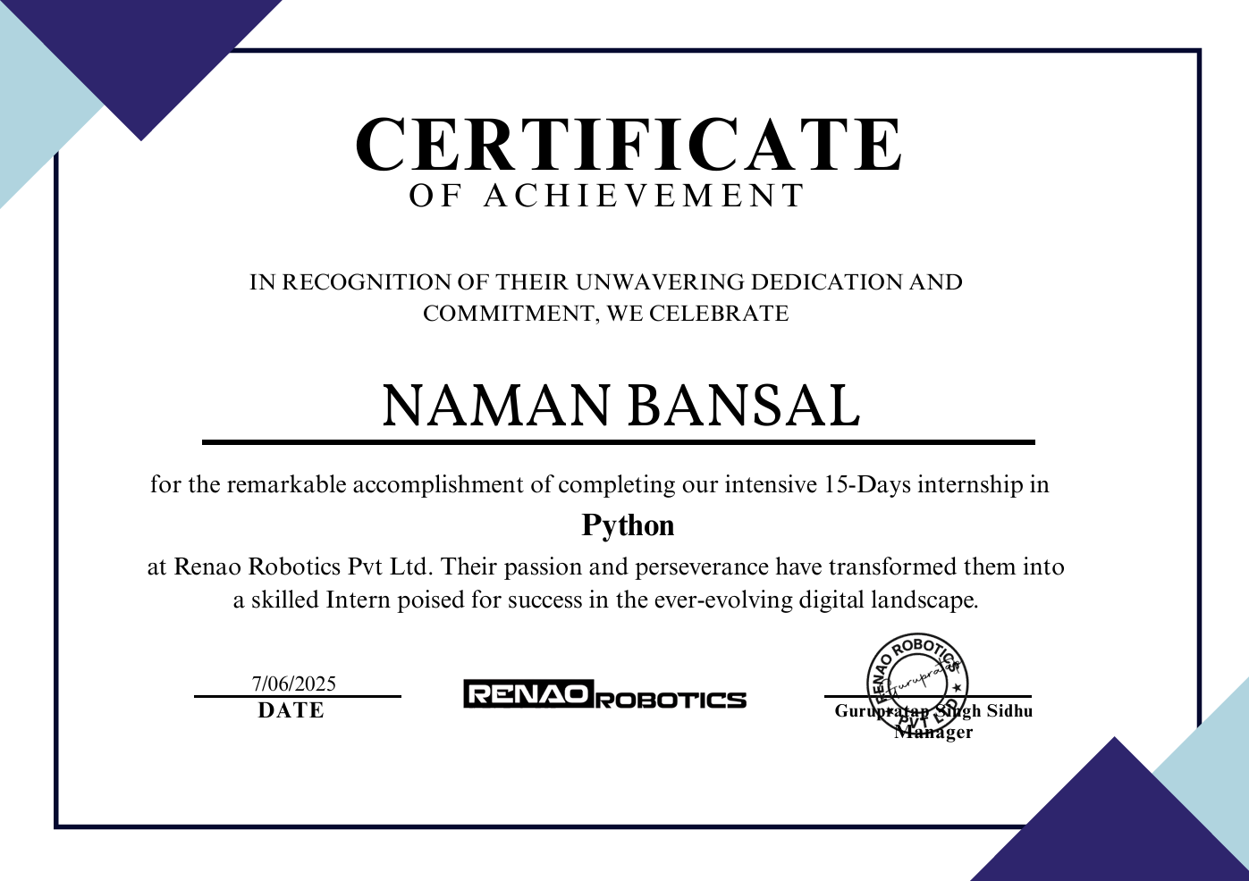
CERTIFICATE

Slide 5
Prerequisites of the Training
Anyone pursuing a professional degree and interested in the technical domain is eligible.
Irrespective of our current college year or the field of our studies, we can apply for this internship.
Anyone want to Learn or get Introduced to Python programming can easily do this training.
Having basic knowledge about programming is required.

Slide 6
Training Description
I have done my internship in Python Programming Language from Renao Robotics Pvt. Ltd.
I have successfully completed my internship under the guidance of Mr. Himanshu Soni.
Mr. Himanshu Soni has a teaching experience of 4 years.
He is working with team UI System for the last 2 years.
Contact Details
Mobile No : +91 9521179009

Slide 7

TECHNOLOGY USED:-
Python
Python is an interpreted, object-oriented, high-level programming language with dynamic semantics. Its high-level built in data structures, combined with dynamic typing and dynamic binding. It was designed with an emphasis on code readability, and its syntax allows programmers to express their concepts in fewer lines of code.
Features of Python :
Free and Open Source
Easy to code
Object-Oriented Language
GUI Programming Support
High-Level Language
Large Community Support

Slide 8
Project Description
Real-Time Weather Application using Python and Weather API :
The project is developed in Python using a Weather API like weatherapi.
Users can enter the name of any city to get current weather details.
Displays key weather details such as temperature, humidity, wind speed, and weather conditions (e.g., sunny, rainy).
Uses HTTPS requests to retrieve data and parses JSON responses.
Handles errors for invalid city names or failed API responses.
Demonstrates API integration and real-world data handling in Python.

Slide 9
Introduction to CV2 Module
The CV2 module of python is an external module that helps to work with images and videos in the python program.
It has to be installed externally to give access to camera for recording images and videos.
To install CV2 the following is typed into command prompt
pip install opencv-python
It contains many expressions file which can be detected using camera like front face detection,full face detection and so-on.

Slide 10
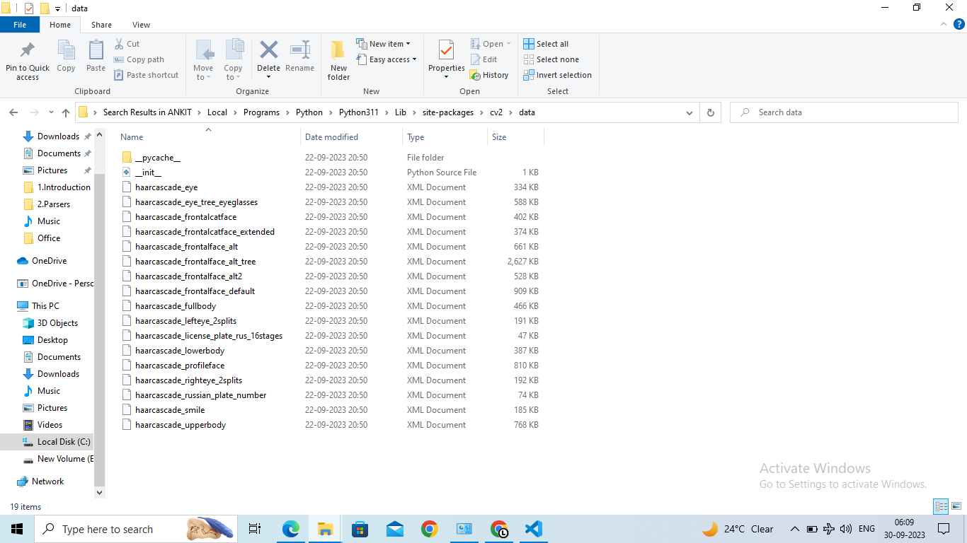

Slide 11
Conclusion and Future Scope
Python is highly recommended for the ML,data-science and AI.
Python is easy to use and has a rich in-built library.
Fully fledged programming language.
Future Scope:
It can be used in many application where human actions has to be recorded.
Highly recommended for Image Processing and graphics jobs.
Penty of job oppportunity every year in python.

Slide 12
References
Python : https://www.python.org/downloads/release/python-381/
CV2 : https://pypi.org/project/opencv-python/
Python extra information : https://www.geeksforgeeks.org/python-programming-language/
For best python courses : https://developer.ibm.com/languages/python/courses/

Slide 13

THANK YOU!

